Slide 1
Wind Turbine
A wind turbine is a rotating machine which converts the kinetic energy in wind into mechanical energy. Then the mechanical energy is then converted to electricity, the machine is called a wind generator, wind turbine, wind power unit (WPU), wind energy converter (WEC), or aerogenerator.
The wind turbines are machines having a rotor with three propeller blades. These blades are explicitly arranged in a horizontal way to push wind for generating electricity.
Wind turbines are placed in those areas having high speeds of wind, to spin the blades much faster for the rotor to transmit the electricity produced to a generator. Finally, the electricity produced is supplied to different stations through the grid.

Slide 2
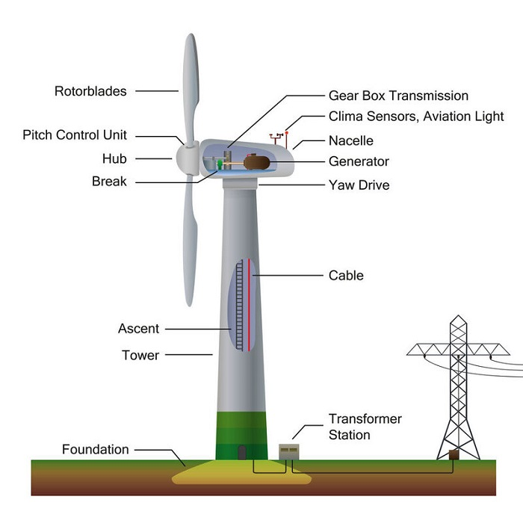
Wind turbine components

Slide 3
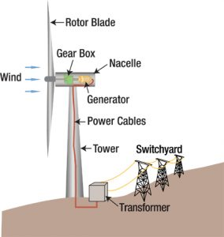
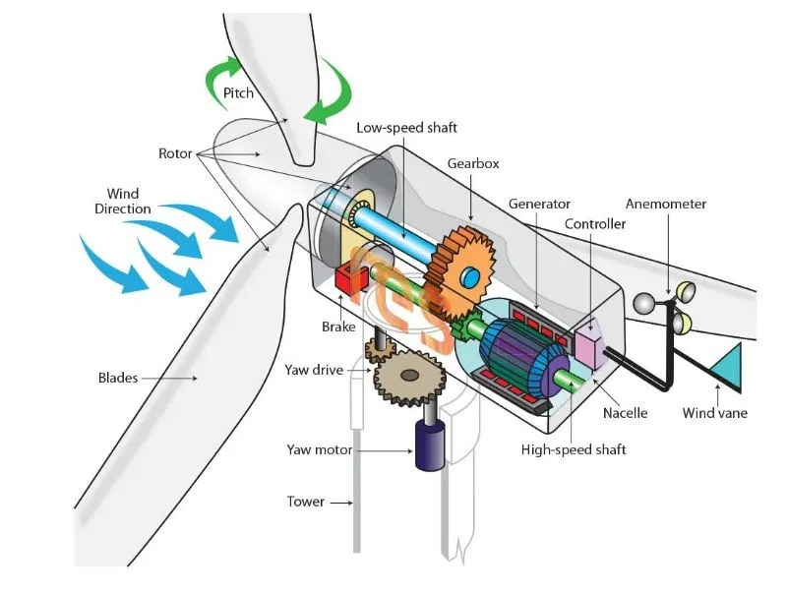

Slide 4
Wind turbine components
The major components of a turbine are:
Tower is the physical structure that holds the wind turbine
Blades are physical structures, which are aerodynamically optimized to capture the maximum power from the wind
Nacelle is the enclosure of the wind turbine generator, gearbox and internal equipment. It protects the turbine‘s internal components from the surrounding environment
Rotor hub

Slide 5
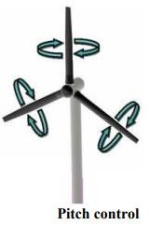
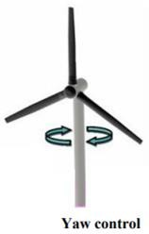
Wind turbine components
Rotor is the rotating part of the wind turbine. It transfers the energy in the wind to the shaft.
Rotor hub holds the wind turbine blades while connected to the gearbox via the low-speed shaft.
Pitch is the mechanism of adjusting the angle of attack of the rotor blades. Blades are turned in their longitudinal axis to change the angle of attack according to the wind directions
Yaw is the horizontal moving part of the turbine. It turns clockwise or anticlockwise to face the wind. It has two main parts
Yaw drive motor rotates the nacelle as it has to face in the direction of the wind to extract the maximum energy from wind
Yaw motor is used to move the yaw

Slide 6
Wind turbine components
Shaft is divided into two.
Low-speed shaft transfers mechanical energy from the rotor to the gearbox,
High-speed shaft transfers mechanical energy from gearbox to generator.
Gearbox is a mechanical component that is used to increase or decrease the rotational speed of generator
Generator is the component that converts the mechanical energy from the rotor to electrical energy
Controller is the brain of the wind turbine. It monitors constantly the condition of the wind turbine and controls the pitch and yaw systems to extract optimum power from the wind.
Wind vane is a type of sensor that is used to measure the wind direction
Anemometer is a type of sensor that is used to measure the wind speed.

Slide 7
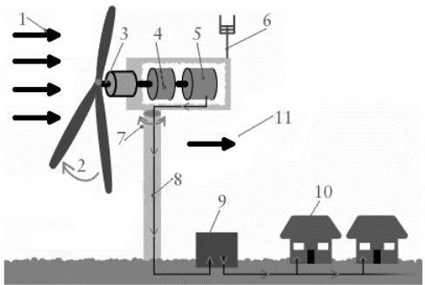
Working of wind power plant

Slide 8
Working of wind power plant
Wind (moving air that contains kinetic energy) blows toward the turbine's rotor blades
The rotors spin around, capturing some of the kinetic energy from the wind, and turning the central drive shaft that supports them
The rotor blades can swivel on the hub at the front so they meet the wind at the best angle (or "pitch") for harvesting energy. This is called the pitch control mechanism.
Inside the nacelle, the gearbox converts the low-speed rotation of the drive shaft into high-speed rotation fast enough to drive the generator efficiently
The generator, immediately behind the gearbox, takes kinetic energy from the spinning drive shaft and turns it into electrical energy

Slide 9
Working of wind power plant
Anemometers (automatic speed measuring devices) and wind vanes on the back of the nacelle provide measurements of the wind speed and direction.
Using these measurements, the entire top part of the turbine (the rotors and nacelle) can be rotated by a yaw motor, mounted between the nacelle and the tower, so it faces directly into the oncoming wind and captures the maximum amount of energy. If it is too windy or turbulent, brakes are applied to stop the rotors from turning
The electric current produced by the generator flows through a cable running down through the inside of the turbine tower.
A step-up transformer converts the electricity to about 50 times higher voltage so it can be transmitted efficiently to the power grid

Slide 10
Working of wind power plant
The consumer enjoy clean, green energy: the turbine has produced no greenhouse gas emissions or pollution as it operates.
Wind carries on blowing past the turbine, but with less speed and energy and more turbulence (since the turbine has disrupted its flow).

